Slide 1
Hidden Markov Model: Forward Algorithm and Viterbi Session 11
Course : COMP6065001 Artificial Intelligence
Effective Period : September 2023

Slide 2
Learning Outcomes
At the end of this session, students will be able to:
LO 3: Apply various techniques to an agent when acting under certainty

Slide 3
Outline
Forward Algorithm
Viterbi
Exercise

Slide 4
Forward Algorithm

Slide 5
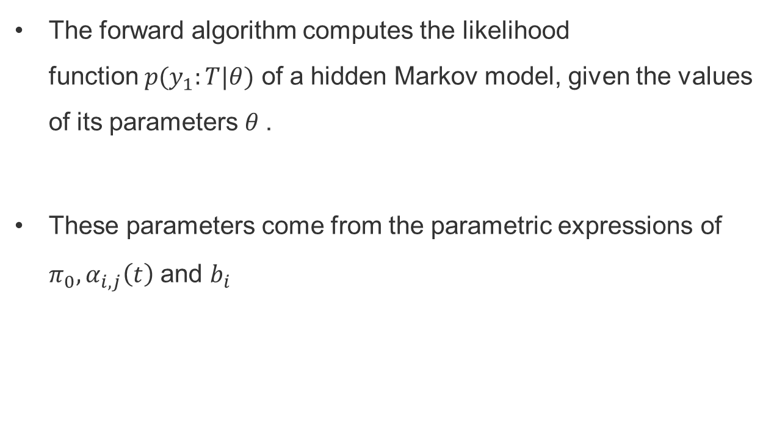
Forward Algorithm
The forward algorithm computes the likelihood function $p(y_{1}:T|θ)$ of a hidden Markov model, given the values of its parameters $θ$.
These parameters come from the parametric expressions of $π_{0}, α_{i,j}\left(t\right)$ and $b_{i}$

Slide 6
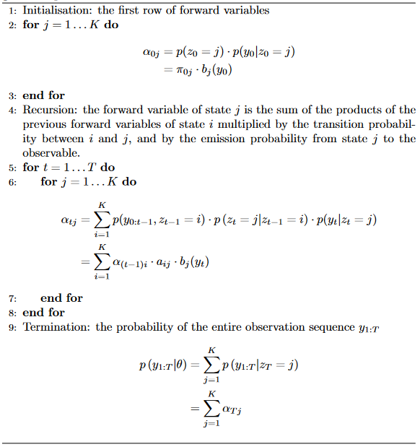
Forward Algorithm

Slide 7
Example: HMM with Forward Algorithm
Consider Jack who is living in Gotham city, the city is unique only have three weather rainy, and sunny and only occur once a day, and tomorrow weather depends on the today weather. In one day, Jack can have two mood sad or happy and depend on weather. Supposed we observed: the first two days Jack is sad, while the third day is happy . What is the probability of this observed sequence given the parameters of our HMM?

Slide 8
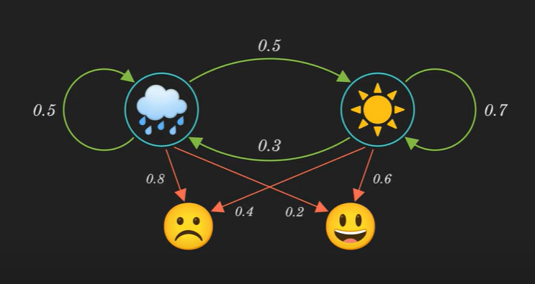
Example: HMM with Forward Algorithm
Here is the transition and emission diagram

Slide 9

Example: HMM with Forward Algorithm
We Write the diagram into Matrix:
$$A= \left[\begin{matrix}0.5 & 0.5 \\ 0.3 & 0.7\end{matrix}\right]$$
$$B= \left[\begin{matrix}0.8 & 0.2 \\ 0.4 & 0.6\end{matrix}\right]$$
$$π=\left[\begin{matrix}0.375 & 0.625\end{matrix}\right]$$

Slide 10
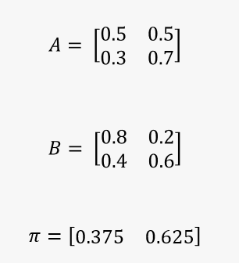
Example: HMM with Forward Algorithm
First Find The Parameter:
Parameters

Slide 11
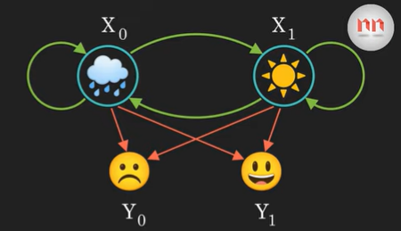
Example: HMM with Forward Algorithm

Slide 12
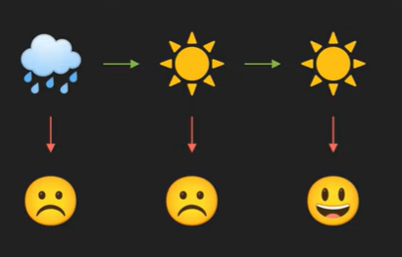
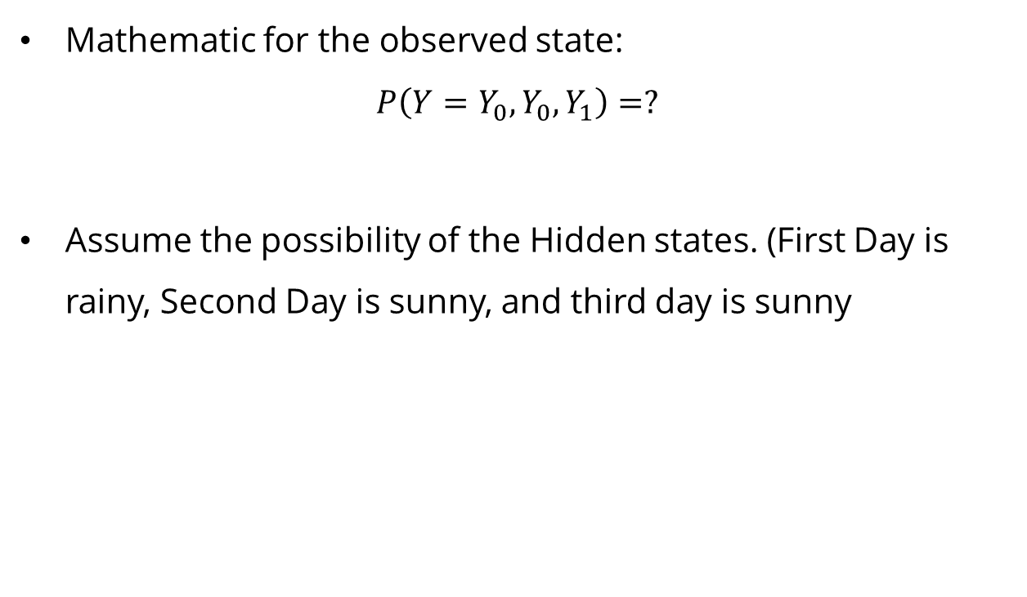
Example: HMM with Forward Algorithm
Mathematic for the observed state: $P\left(Y=Y_{0}, Y_{0}, Y_{1}\right)=?$
Assume the possibility of the Hidden states. (First Day is rainy, Second Day is sunny, and third day is sunny

Slide 13
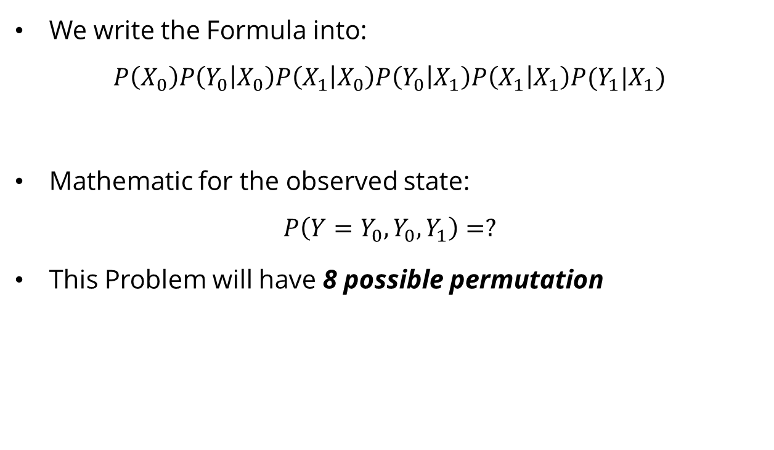
Example: HMM with Forward Algorithm
We write the Formula into:
$$P\left(X_{0}\right)P\left(Y_{0} | X_{0}\right)P\left(X_{1} | X_{0}\right)P\left(Y_{0} | X_{1}\right)P\left(X_{1} | X_{1}\right)P(Y_{1}|X_{1})$$
Mathematic for the observed state: $P\left(Y=Y_{0}, Y_{0}, Y_{1}\right)=?$
This Problem will have 8 possible permutation

Slide 14

Example: HMM with Forward Algorithm
Here is the possible Permutation:

Slide 15
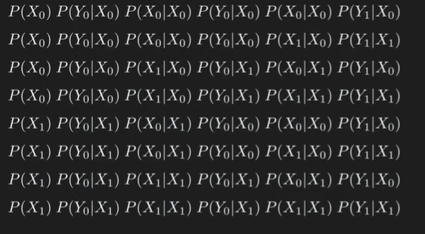
Example: HMM with Forward Algorithm

Slide 16
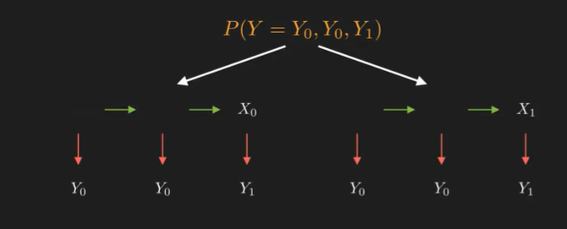
Example: HMM with Forward Algorithm
We could create a tree, with the last hidden state is X0 or X1

Slide 17
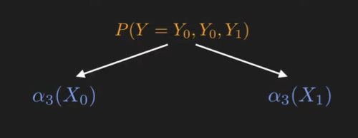

Example HMM with Forward Algorithm
Then we denoted the missing with $α_{3}$ with 3 is the length of sequence

Slide 18
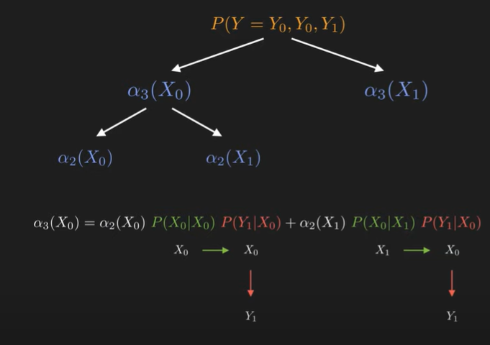
Example: HMM with Forward Algorithm
We decompose it more and Formulation

Slide 19
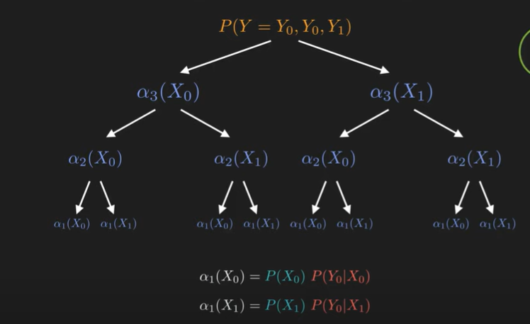
Example: HMM with Forward Algorithm

Slide 20
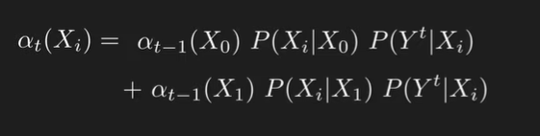
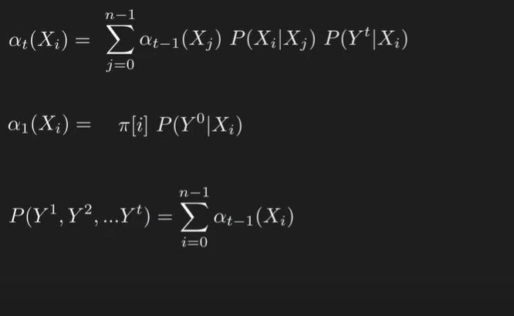
Example: HMM with Forward Algorithm

Slide 21
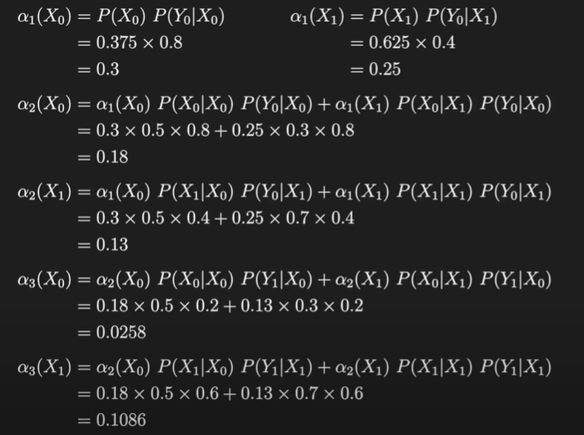
Example: HMM with Forward Algorithm

Slide 22
Example HMM with Forward Algorithm

Slide 23
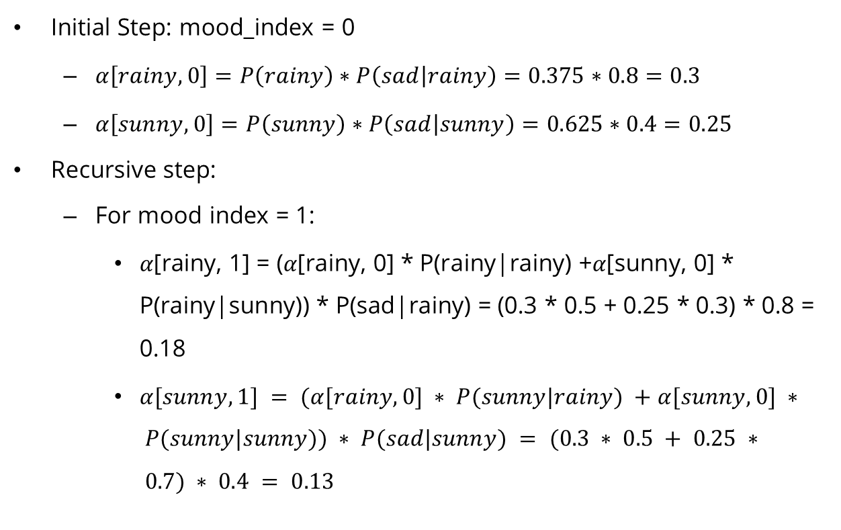
Example HMM with Forward Algorithm
Initial Step: mood_index = 0
$α\left[rainy, 0\right]=P\left(rainy\right)∗P\left(sad | rainy\right)=0.375∗0.8=0.3$
$α\left[sunny, 0\right]=P\left(sunny\right)∗P\left(sad | sunny\right)=0.625∗0.4=0.25$
Recursive step:
For mood index = 1:
$α\text{[}\text{rainy}\text{, 1] = (}α\text{[}\text{rainy}\text{, 0] ∗ }\text{P}\text{(}\text{rainy}\text{|}\text{rainy}\text{) +}α\text{[}\text{sunny}\text{, 0] ∗ }\text{P}\text{(}\text{rainy}\text{|}\text{sunny}\text{)) ∗ }\text{P}\text{(}\text{sad}\text{|}\text{rainy}\text{) = (0.3 ∗ 0.5 + 0.25 ∗ 0.3) ∗ 0.8 = 0.1}\text{8}$
$α[sunny, 1] = (α[rainy, 0] ∗ P(sunny|rainy) +α[sunny, 0] ∗ P(sunny|sunny)) ∗ P(sad|sunny) = (0.3 ∗ 0.5 + 0.25 ∗ 0.7) ∗ 0.4 = 0.13$

Slide 24
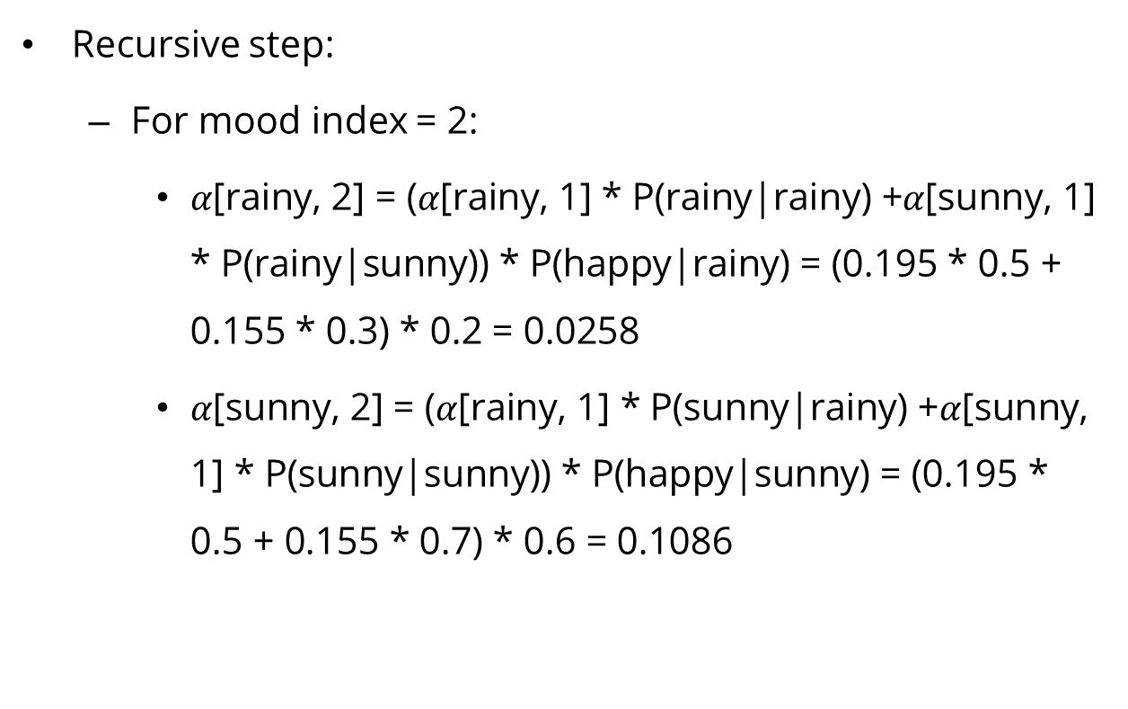
Example HMM with Forward Algorithm
Recursive step:
For mood index = 2:
$α\text{[}\text{rainy}\text{, 2] = (}α\text{[}\text{rainy}\text{, 1] ∗ }\text{P}\text{(}\text{rainy}\text{|}\text{rainy}\text{) +}α\text{[}\text{sunny}\text{, 1] ∗ }\text{P}\text{(}\text{rainy}\text{|}\text{sunny}\text{)) ∗ }\text{P}\text{(}\text{happy}\text{|}\text{rainy}\text{) = (0.195 ∗ 0.5 + 0.155 ∗ 0.3) ∗ 0.2 = 0.02}\text{58}$
$α\text{[}\text{sunny}\text{, 2] = (}α\text{[}\text{rainy}\text{, 1] ∗ }\text{P}\text{(}\text{sunny}\text{|}\text{rainy}\text{) +}α\text{[}\text{sunny}\text{, 1] ∗ }\text{P}\text{(}\text{sunny}\text{|}\text{sunny}\text{)) ∗ }\text{P}\text{(}\text{happy}\text{|}\text{sunny}\text{) = (0.195 ∗ 0.5 + 0.155 ∗ 0.7) ∗ 0.6 = 0.1}$086

Slide 25
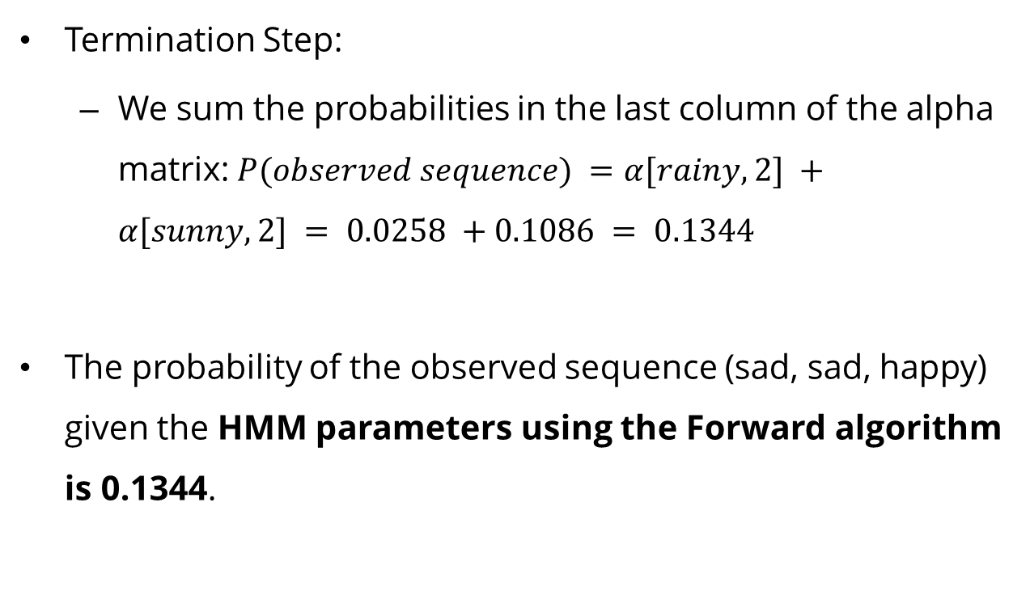
Example HMM with Forward Algorithm
Termination Step:
We sum the probabilities in the last column of the alpha matrix:$P(observed sequence) =α[rainy, 2] +α[sunny, 2] = 0.0258 +0.1086 = 0.1344$
The probability of the observed sequence (sad, sad, happy) given the HMM parameters using the Forward algorithm is 0.1344.

Slide 26
Viterbi Algorithm

Slide 27
Viterbi Algorithm
Supposing a trained HMM with known parameters in the initial probability π0, transition matrix A(t) and emission probabilities b(y); the Viterbi algorithm finds the best sequence of hidden states, so that their probability conditioned on the data y0:T0 is at a maximum:

Slide 28
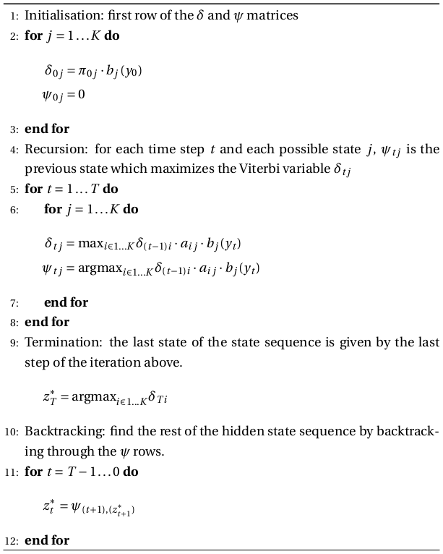
Viterbi Algorithm

Slide 29
Example: HMM with Viterbi Algorithm
Consider Jack who is living in Gotham city, the city is unique only have three weather rainy, and sunny and only occur once a day, and tomorrow weather depends on the today weather. In one day, Jack can have two mood sad or happy and depend on weather. Supposed we observed: the first two days Jack is sad, while the third day is happy . What is the probability of this observed sequence given the parameters of our HMM with Viterbi Algorithm?

Slide 30
Example: HMM with Viterbi Algorithm
Here is the transition and emission diagram

Slide 31
Example: HMM with Viterbi Algorithm
We Write the diagram into Matrix:
$$A= \left[\begin{matrix}0.5 & 0.5 \\ 0.3 & 0.7\end{matrix}\right]$$
$$B= \left[\begin{matrix}0.8 & 0.2 \\ 0.4 & 0.6\end{matrix}\right]$$
$$π=\left[\begin{matrix}0.375 & 0.625\end{matrix}\right]$$

Slide 32
Example: HMM with Viterbi Algorithm
First Find The Parameter:
Parameters

Slide 33
Example: HMM with Viterbi Algorithm
Initialize Step: Mood_index = 0
V(rainy, 0) = P(rainy)*P(sad|rainy) = 0.375*0.8 =0.3
V(sunny, 0) = P(sunny)*P(sad|sunny) = 0.625*0.4 = 0.25
Recursive Step: Mood_index = 1
V(rainy, 1) = max(V[rainy, 0] * P(rainy|rainy), V[sunny, 0] * P(rainy|sunny)) * P(sad|rainy) = max(0.3 * 0.5, 0.25 * 0.3) * 0.8 = 0.12
V[sunny, 1] = max(V[rainy, 0] * P(sunny|rainy), V[sunny, 0] * P(sunny|sunny)) * P(sad|sunny) = max(0.3 * 0.5, 0.25 * 0.7) * 0.4 = 0.07

Slide 34
Example: HMM with Viterbi Algorithm
Recursive Step: Mood_index = 2
V[rainy, 2] = max(V[rainy, 1] * P(rainy|rainy), V[sunny, 1] * P(rainy|sunny)) * P(happy|rainy) = max(0.12 * 0.5, 0.07 * 0.3) * 0.2 = 0.012
V[sunny, 2] = max(V[rainy, 1] * P(sunny|rainy), V[sunny, 1] * P(sunny|sunny)) * P(happy|sunny) = max(0.12 * 0.5, 0.07 * 0.7) * 0.6 = 0.042

Slide 35
Example: HMM with Viterbi Algorithm
Termination step:
Finally, we choose the maximum probability from the last column of the Viterbi matrix:
max(V[rainy, 2], V[sunny, 2]) = max(0.012, 0.042) = 0.042
The probability of the observed sequence (sad, sad, happy) given the HMM parameters is 0.042.

Slide 36
Exercise

Slide 37
Exercise
Consider Jack who is living in Gotham city, the city is unique only have three weather rainy, and sunny and only occur once a day, and tomorrow weather depends on the today weather. In one day, Jack can have two mood sad or happy and depend on weather. Supposed we observed: the first two days Jack is happy, while the third day is sad . What is the probability of this observed sequence given the parameters of our HMM with Viterbi Algorithm and Forward Algorithm?
Note: The Initial Probability P(rainy) = 0.35; P(sunny) = 0.65

Slide 38
Exercise

Slide 39
References
Stuart Russell, Peter Norvig. 2020. Artificial Intelligence : A Modern Approach. Pearson Education. New Jersey. ISBN:9780132071482
Christopher M. Bishop, 2006. Pattern Recognition and Machine Learning. Springer
https://www.cs.toronto.edu/~axgao/cs486686_f21/lecture_notes/Lecture_14_on_Hidden_Markov_Models_1.pdf
https://bookdown.org/probability/beta/markov-chains.html
https://www.stat.auckland.ac.nz/~fewster/325/notes/ch8.pdf

Slide 40
References
https://www.youtube.com/watch?v=1GKtfgwf3ig&t=78s
https://www.youtube.com/watch?v=rHdX3ANxofs
https://www.cs.mcgill.ca/~dprecup/courses/ML/Lectures/ml-lecture-hmm.pdf
https://cse.buffalo.edu/~jcorso/t/CSE555/files/lecture_hmm.pdf
https://medium.com/@postsanjay/hidden-markov-models-simplified-c3f58728caab

Slide 41
References
https://buildingenergygeeks.org/hmm.html

